Slide 1
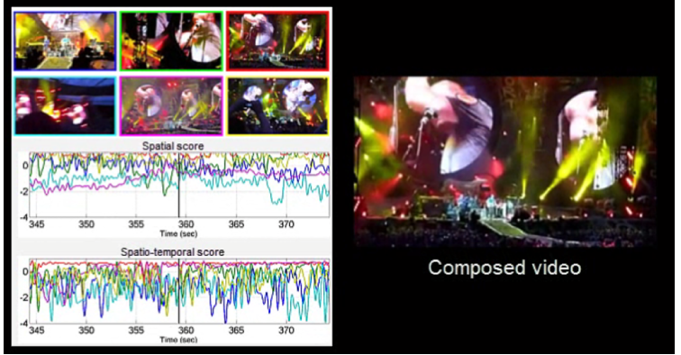
Multi-camera User-Generated Video composition
Audio and visual-based video composition
Spatial and spatio-temporal assessments
View diversity and ranked-based camera selection
S. Bano, A. Cavallaro. ViComp: Composition of User-Generated Videos. Multimedia Tools and Applications, 2016

Slide 2
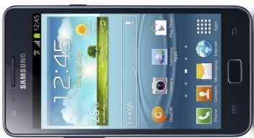
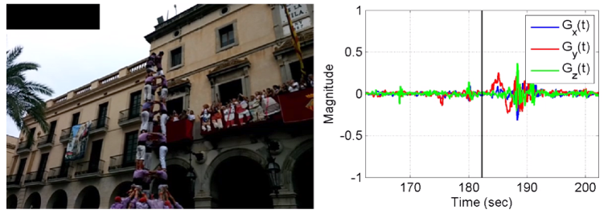
Gyro-based Video Analysis of UGVs
x
Gyro-based camera-motion detection
Need to synchronise the gyro-visual data
Motion detection from filtered gyroscope data
Collection of 24 multi-modal user-generated videos (UGVs) using smartphones
G_{x}(t)
G_{y}(t)
z
y
G_{z}(t)
S. Bano, A. Cavallaro, X. Parra. Gyro-based camera motion detection in user-generated videos. ACM Multimedia, 2015
Notes:
Independent of object motion and lighting changes

Slide 3
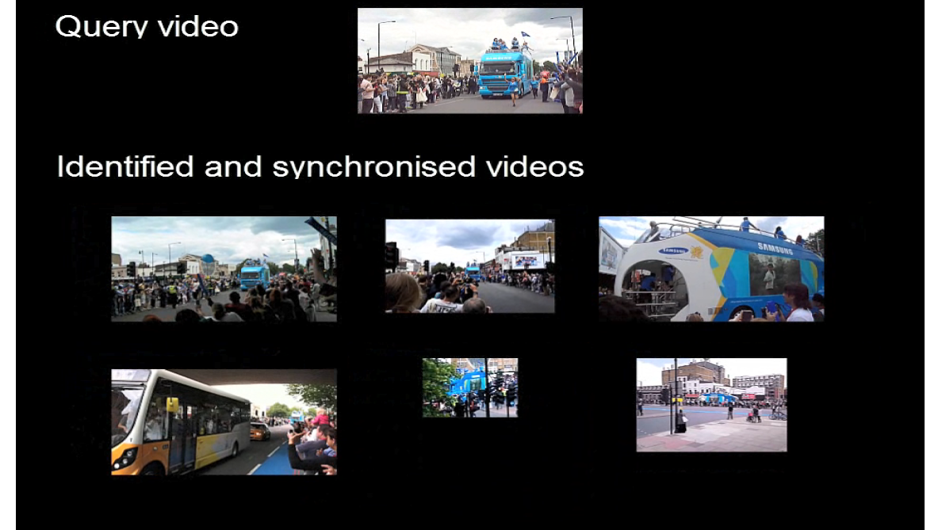
Identification and Synchronisation of UGVs
Develop using audio chroma feature
Match and cluster user-generated videos (UGVs) that capture the same spatio-temporal event
Estimate the time-shift for synchronization
S. Bano, A. Cavallaro. Discovery and organization of user-generated videos of the same event. Information Sciences, 302:108-121, 2015.

Slide 4
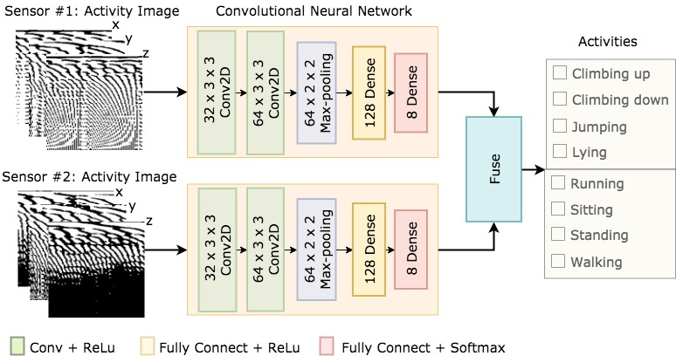
Deep Human Activity Recognition using Wearable Sensors
Feature generation
Classification
Sensing
Activity images
Human activity recognition using convolutional neural network
Activity image generation by applying FFT on the triaxial accelerometer and gyroscope signals
RealWorld (HAR) dataset used for the validation (dataset: https://sensor.informatik.uni-mannheim.de)
IA. Lawal, S. Bano. Deep human activity recognition using wearable sensors. PETRA, 2019

Slide 5
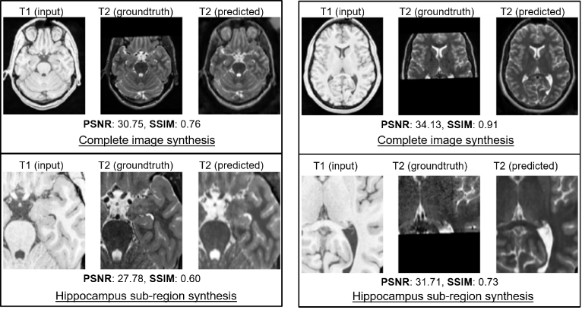
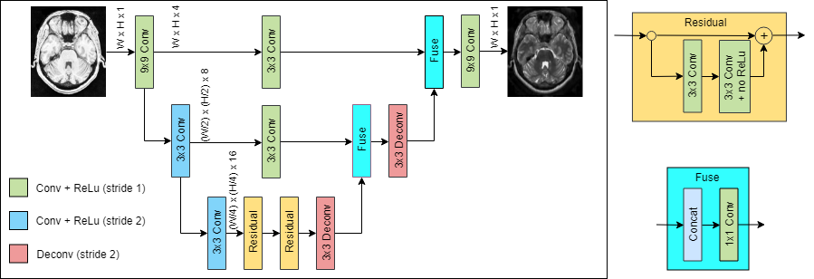
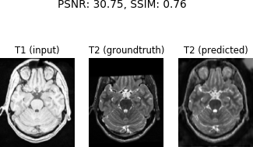
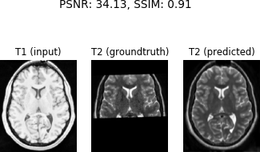
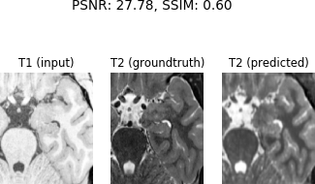
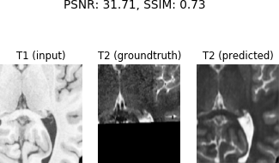
XmoNet: a Fully Convolutional Network for Cross-Modality MR Image Inference
A deep learning architecture for cross-modality inference
Synthesizes a target modality (T2) given a separate source (T1)
XmoNet utlilises parallel pathways to encode low- and high-frequency visual features
MNI-HISUB25 dataset used for the validation (dataset: https://www.nitrc.org/projects/mni-hisub25)
S. Bano, M. Asad, A. Fetit, I. Rekik. XmoNet: a Fully Convolutional Network for Cross-Modality MR Image Inference. MICCAI PRIME workshop, 2018
T1 (input) T2 (groundtruth) T2 (predicted)
T1 (input) T2 (groundtruth) T2 (predicted)
PSNR: 30.75, SSIM: 0.76
PSNR: 34.13, SSIM: 0.91
Complete image synthesis
Complete image synthesis
T1 (input) T2 (groundtruth) T2 (predicted)
T1 (input) T2 (groundtruth) T2 (predicted)
PSNR: 27.78, SSIM: 0.60
PSNR: 31.71, SSIM: 0.73
Hippocampus sub-region synthesis
Hippocampus sub-region synthesis

Slide 6
Focused Interaction Detection using Multimodal Features
Fusion of multimodal features improve the overall focused interaction detection
Released the Multimodal Focused Interaction Dataset for benchmarking
(Dataset: https://cvip.computing.dundee.ac.uk/datasets/focusedinteraction/)
HOG: Histogram of Oriented Gradient
KLT: Kanade-Lucas-Tomasi Tracker
HOOF: Histogram of Oriented Optical Flow
VAD: Voice Activity Detection
Learning
(SVM/
LSTM)
S. Bano, et al.. Multimodal Egocentric Analysis of Focused Interactions. IEEE Access, Vol. 6, 2018
S Bano, et al.. Finding Time Together: Detection and Classification of Focused Interaction in Egocentric Video, ICCV EPIC workshop 2017

Slide 7
Deep Learning-based Anatomical Site Classification for Upper Gastrointestinal Endoscopy
Proposed guideline has 3 more landmarks than the British guideline
Enables automatic photo-documentation of upper GI endoscopy
Q. He, S. Bano, O. F. Ahmad, B. Yang, X. Chen, P. Valdastri, D. Stoyanov, S. Zuo, Deep Learning Based Anatomical Site Classification for Upper Gastrointestinal Endoscopy, IJCARS, 2020

Slide 8
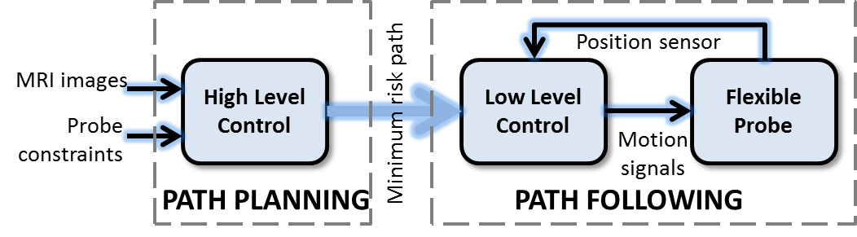
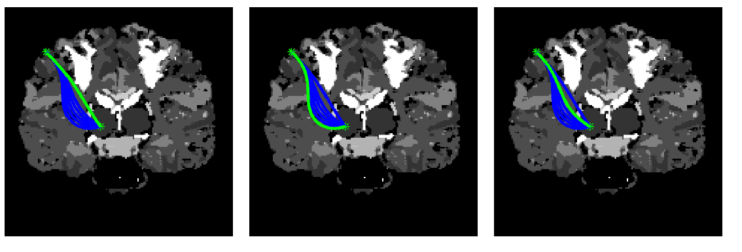
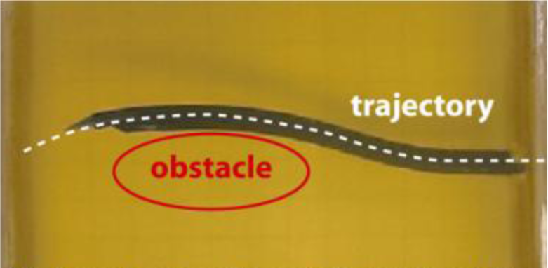
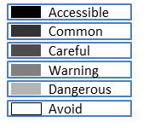


Smooth Path Planning for a Biologically-Inspired Neurosurgical Probe
Optimal path finder that
Respect the mechanical constraints of the probe
Minimizes the risk through obstacle avoidance
Gradient-based method for curvature optimization
System architecture of the flexible probe
Flexible probe in gelatine
Shortest path
Path with maximum clearance from the obstacle
Path with minimum risk
S. Bano, S. Y. Ko and F. Rodriguez y Baena, Smooth Path Planning for a Biologically-Inspired Neurosurgical Probe, EMBC, 2012

Slide 9
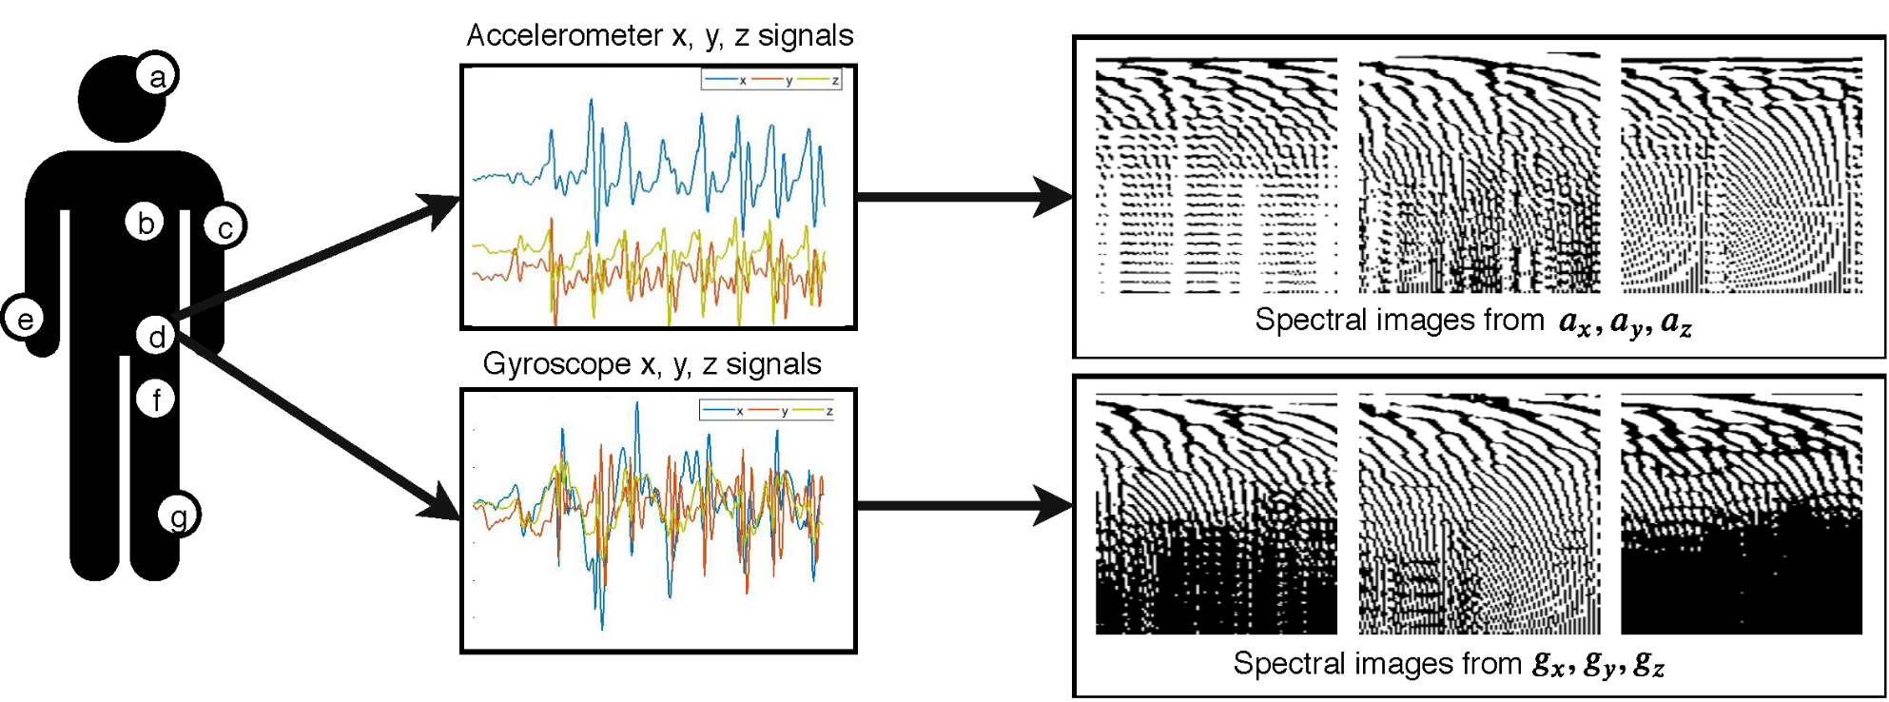
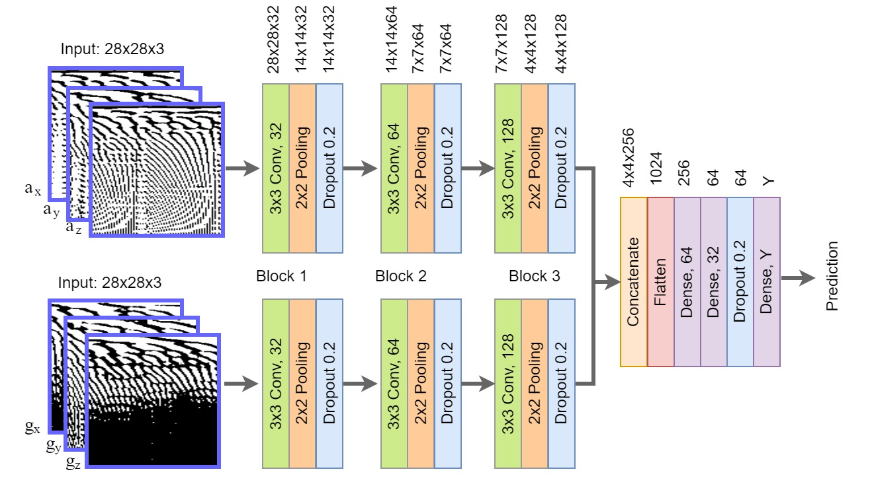
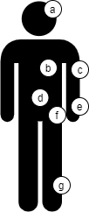
Deep Human Activity Recognition with Localisation of Wearable Sensors
Motion Signals
Activity Image Generation
Network Architecture for Classification
Motion sensors at location
(a) Head (e) Wrist
(b) Chest (f) Thigh
(c) Arm (g) Shin
(d) Waist
IA. Lawal, S. Bano. Deep Human Activity Recognition with Localisation of Wearable Sensors. IEEE Access, 2020

Slide 10
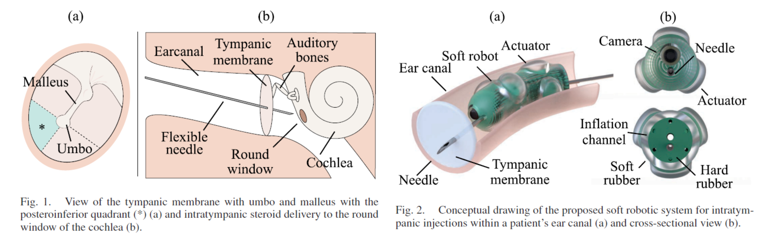
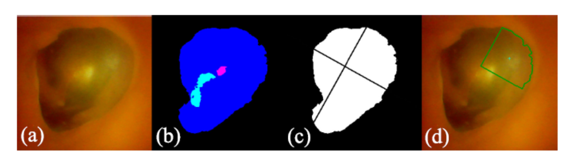
A Fluidic Soft Robot for Needle Guidance and Motion Compensation in Intratympanic Steroid Injections
(Left) Tympanic membrane with umbo, malleus and the posteroinferior quadrant(*).
(Right) Intratympanic steroid delivery to the round window of the cochlea.
Conceptual drawing of the proposed soft robotic system for intratympanic injection
Conceptual drawing of the proposed soft robotic system for intratympanic injection
A soft robot system for intratympanic steroid injection that
actively steer inside a lumen to guide a needle towards a desired point.
compensate hand motion by actively controllable mechanical coupling.
autonomously identify the desired insertion point for injection.
Overview of the proposed vision algorithm with the original image (a), predicted segmentation (b), calculated quadrant mask (c) and final insertion point (d)
L. Lindenroth, S. Bano, A. Stilli, JG. Manjaly, D. Stoyanov. A Fluidic Soft Robot for Needle Guidance and Motion Compensation in Intratympanic Steroid Injections. IEEE Robotics and Automation Letters, 2021

Slide 11
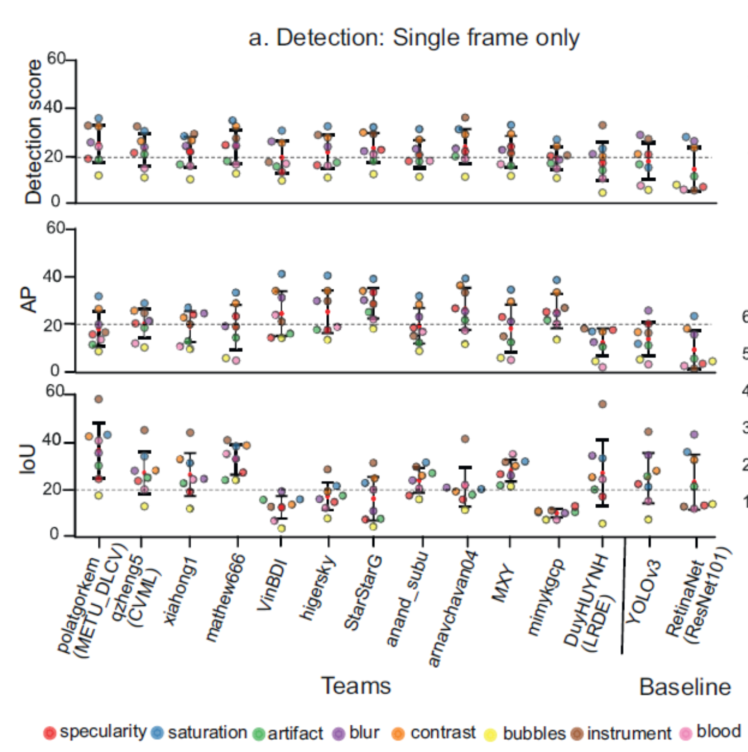
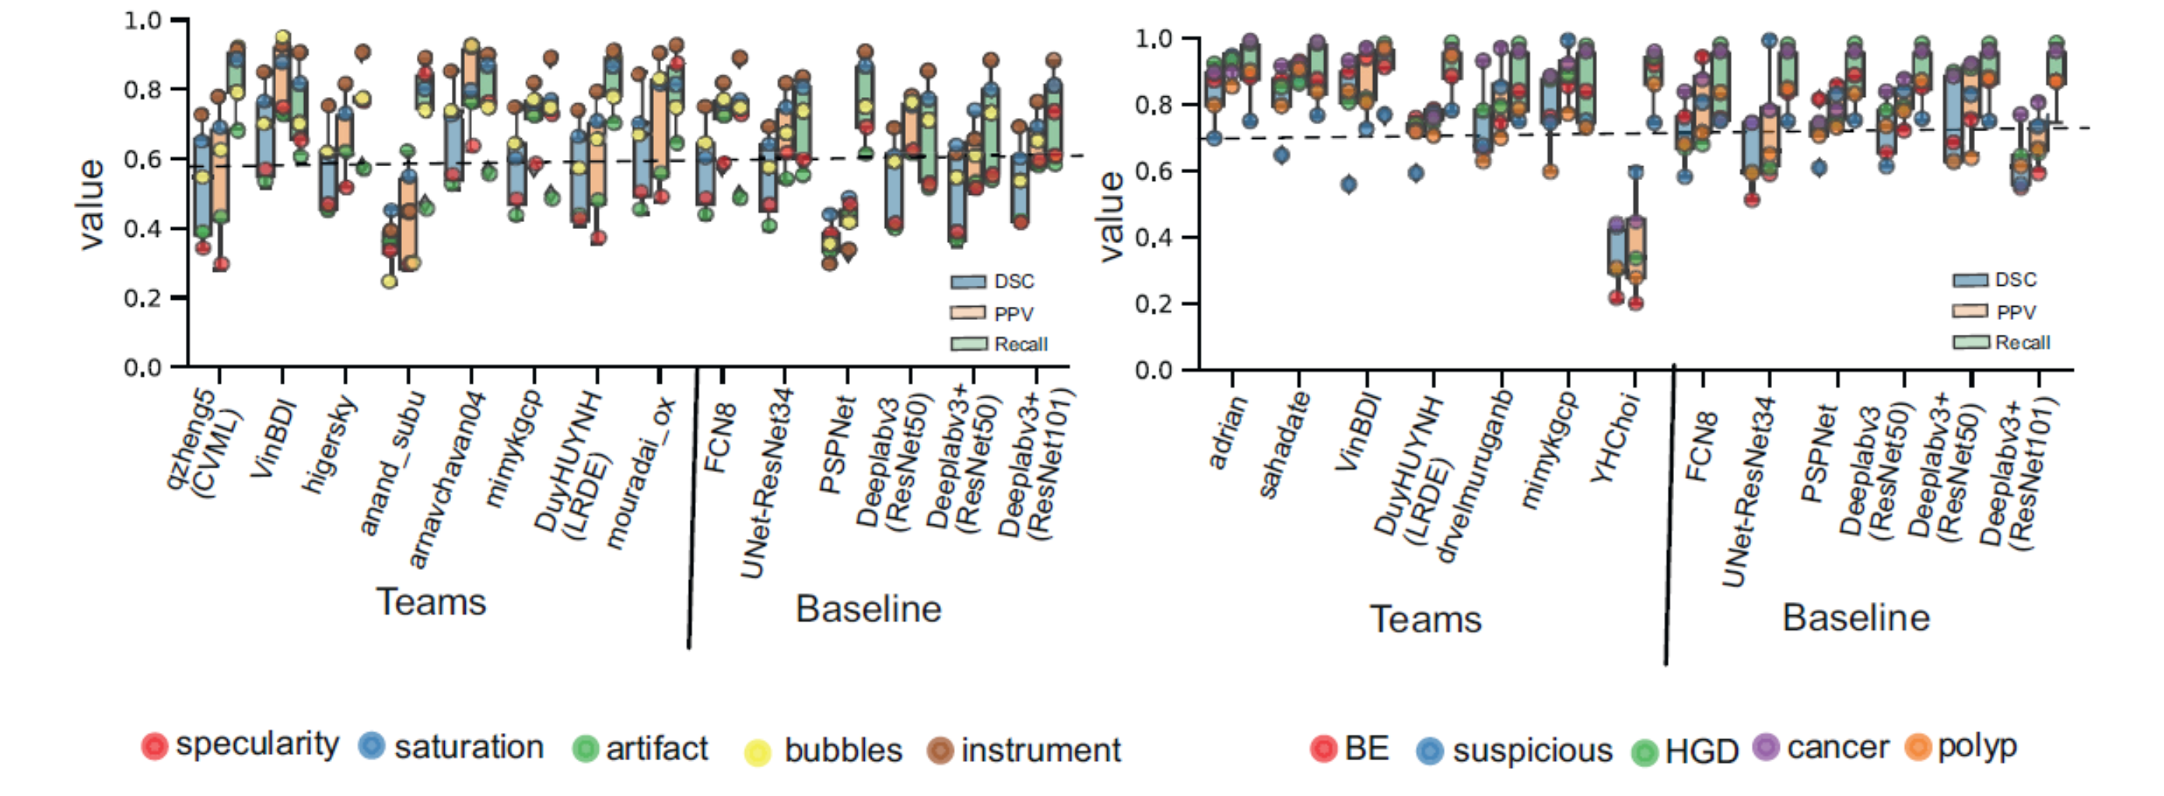
Deep learning for detection and segmentation of artefact and disease instances in gastrointestinal endoscopy
EAD2020 Detection Analysis
Endoscopy Artefact Detection (EAD) and segmentation
EAD2020 Segmentation Analysis
EDD2020 Segmentation Analysis
Endoscopy Disease Detection (EDD) and segmentation
S. Ali, M. Dmitrieva, N. Ghatwary, S. Bano, G. Polat, A. Temizel, A. Krenzer et al.. Deep learning for detection and segmentation of artefact and disease instances in gastrointestinal endoscopy. Medical Image Analysis, 2021

Slide 12

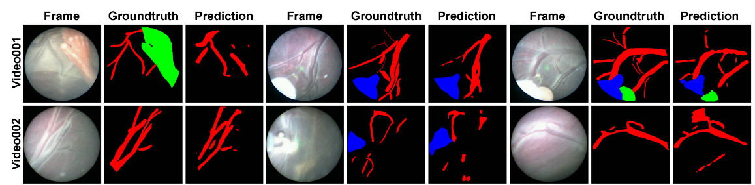
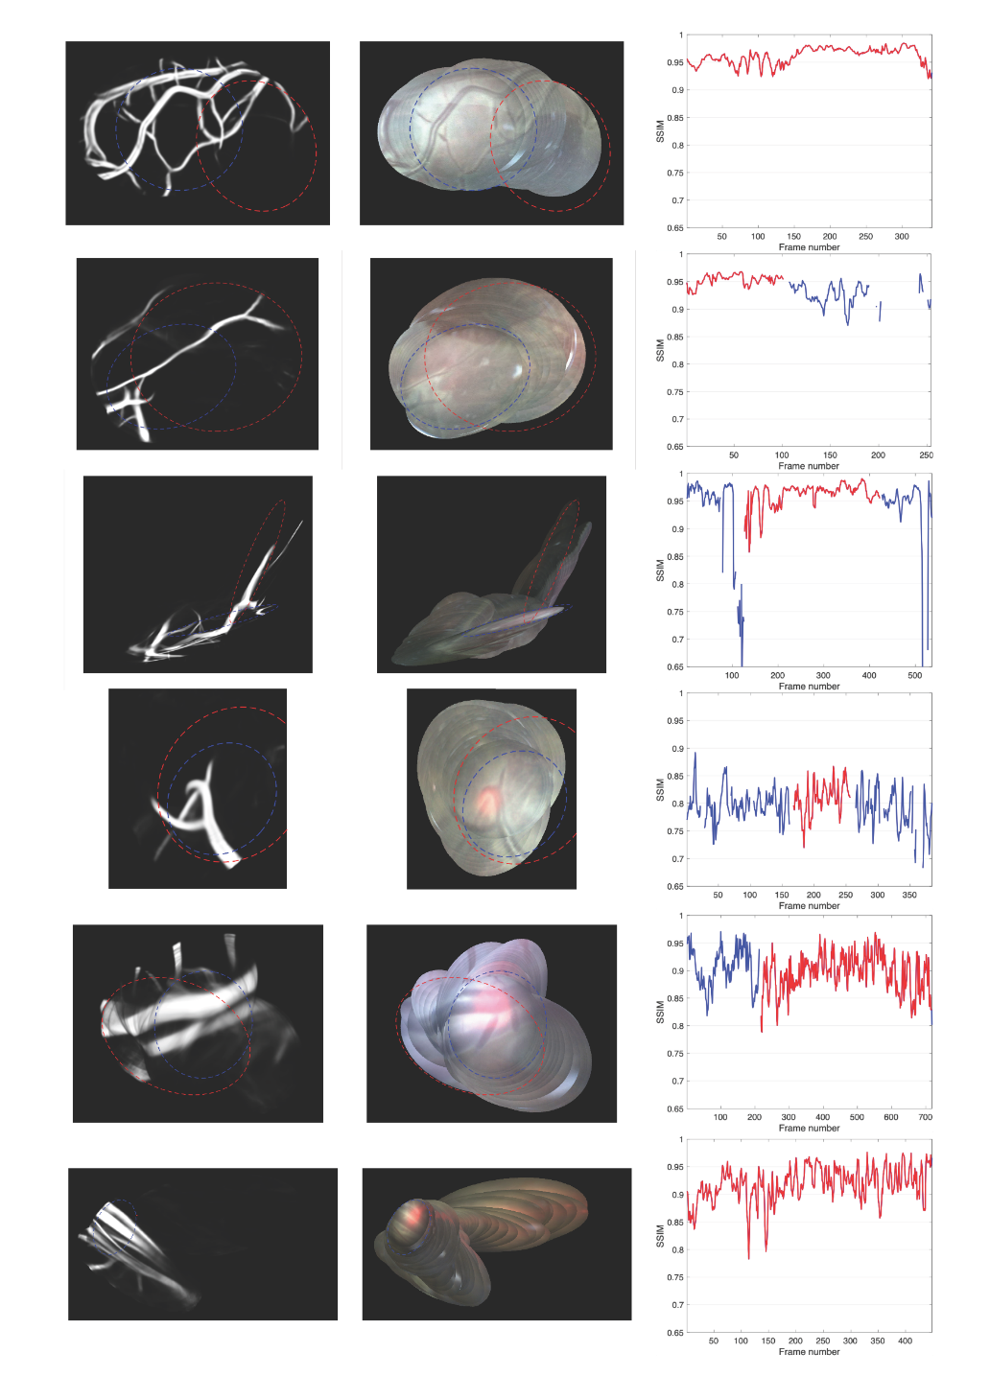
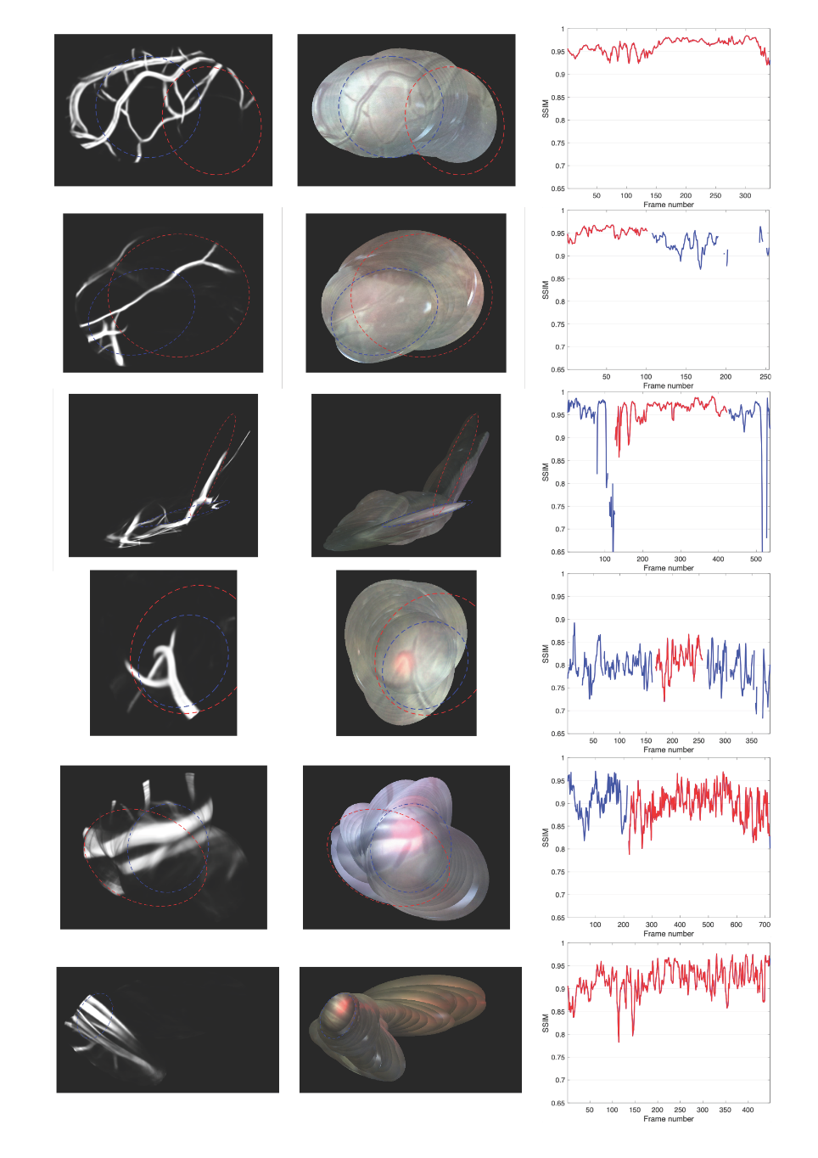
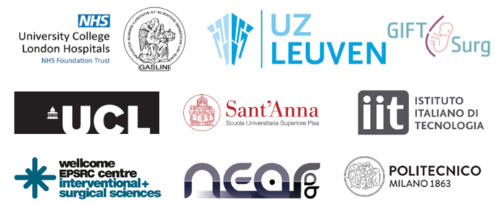
FetReg: Placental Vessel Segmentation and Registration in Fetoscopy Challenge Dataset
First largescale multi-centre fetoscopy dataset
A crowd-sourcing initiative
Aim to design generalized algorithms
Placental scene segmentation
Video mosaicking
Data Description
Samples from 18 TTTS fetoscopy videos
2060 images with pixelwise annotations
Three class labels: Vessels, laser ablation fibre, fetus
18 fetoscopy clips for registration
7411 unannotated frames
Video001
Video002
S. Bano, A. Casella, F. Vasconcelos, S. Moccia, G. Attilakos, R. Wimalasundera, A. L. David, D. Paladini, J. Deprest, E. D. Momi, L. S. Mattos, D. Stoyanov. FetReg: Placental Vessel Segmentation and Registration in Fetoscopy Challenge Dataset. Arxiv, 2021

Slide 13
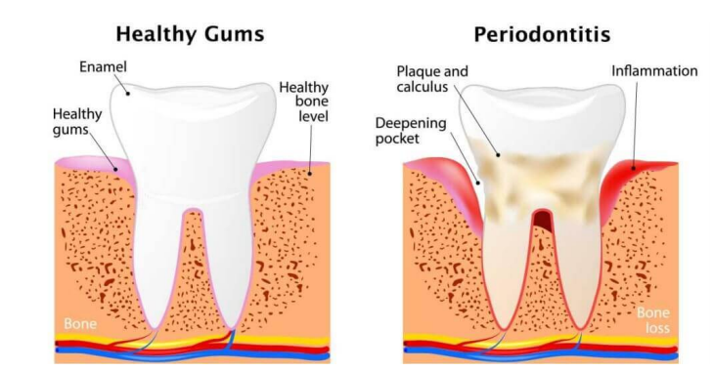
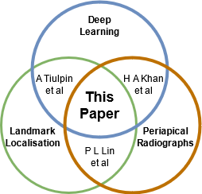
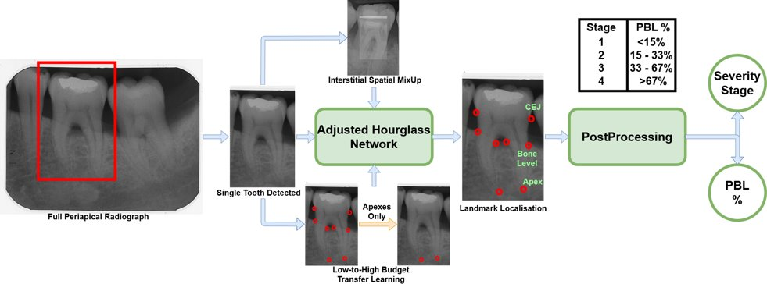
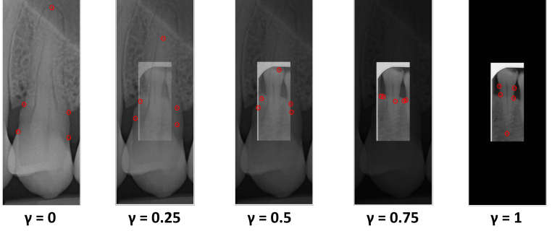
Automating Periodontal Bone Loss (PBL) Measurement via Dental Landmark Localisation
Motivation
PBL → Periodontal Disease
Contributions
1st to use Deep Learning for Landmark Localisation on Periapical Radiographs
Introduces Interstitial Spatial MixUp (ISM) as novel data augmentation
Extensive qualitative evaluation on numerous root morphologies
Automating PBL measurement can improve:
Objectivity – Currently high interobserver error
Intervention – reliably track disease progression
Outcome – early-stage preventive action
ISM – novel interpolation of two images
R.P. Danks, S. Bano, A. Orishko, H.J. Tan, F.M. Sancho, F. D'Aiuto, & D. Stoyanov, Automating Periodontal Bone Loss Measurement via Dental Landmark Localisation, IJCARS, 2021

Slide 14
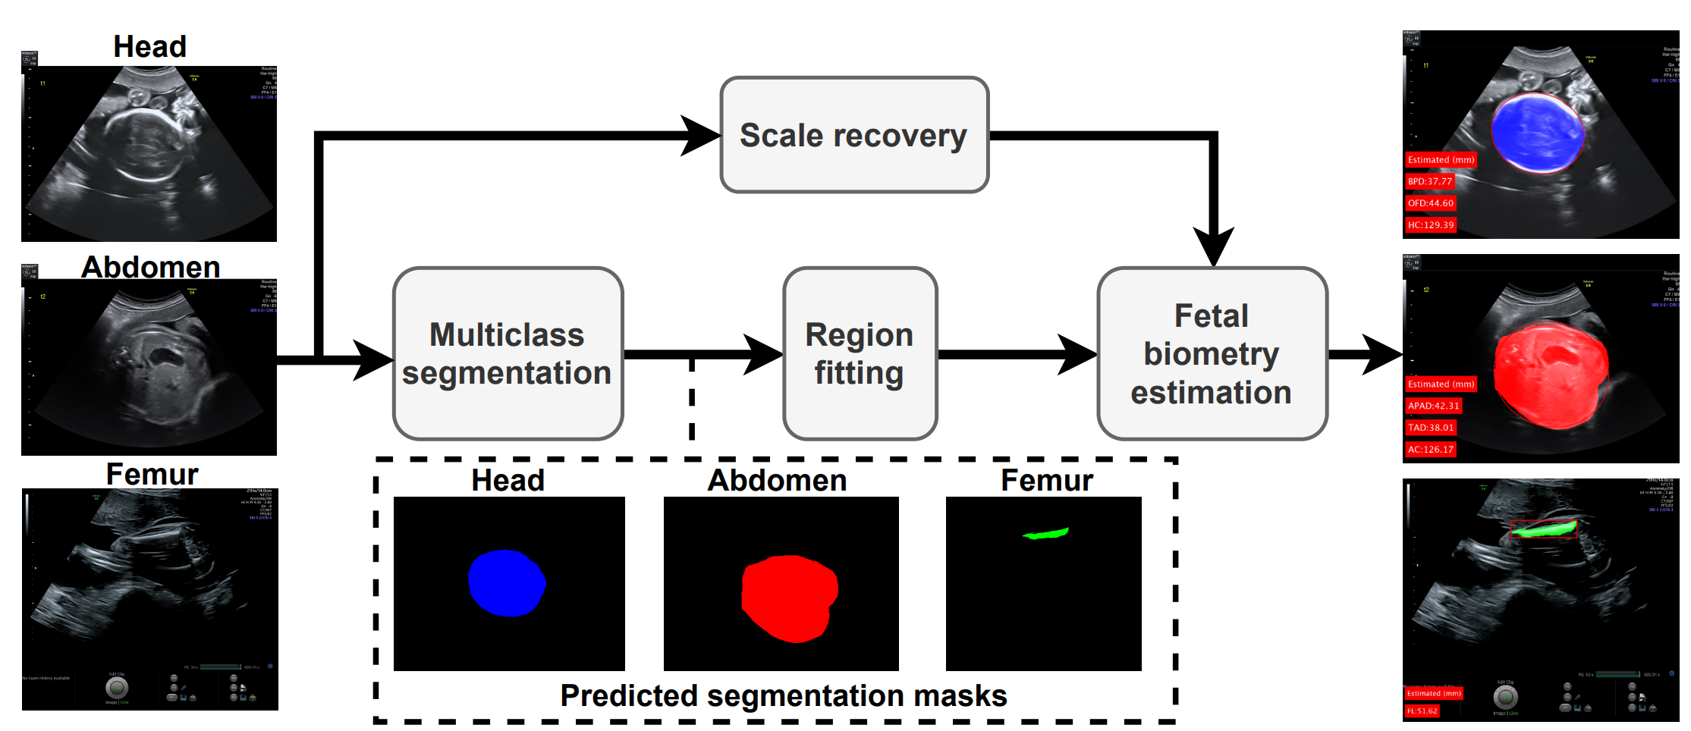
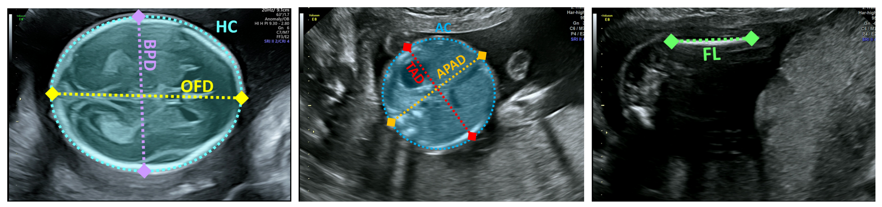
AutoFB: Automating Fetal Biometry Estimation from Standard Ultrasound Planes
Fetal biometry from (left) transventricular plane in the head, (middle) transabdominal plane in the abdomen and (right) femur plane
Contributions
Unified automated fetal biometry estimation framework
First to automate fetal biometry estimation from all ultrasound planes
Estimates all relevant measurements for fetal weight assessment
Tested on real clinical ultrasound data acquired from 42 different prengencies
AutoFB framework overview: Given an ultrasound image of a standard plane, AutoFB performs multi-class segmentation, followed by shape fitting and scale recovery
Motivation
Enable monitoring fetal growth, a task currently affected by high inter-operator variability
S. Bano, B. Dromey, F. Vasconcelos, R. Napolitano, A. L. David, D. M. Peebles, D. Stoyanov. AutoFB: Automating Fetal Biometry Estimation from Standard Ultrasound Planes. 24th International Conference on Medical Image Computing and Computer Assisted Intervention (MICCAI), 2021

